Slide 1

PERSONAL BRANDING ON SOCIAL MEDIA
STRATEGY AND IMPLEMENATION PLAN
{Yangha Park}
{Yangha Park}
{22/09/2018}

Slide 2
contents
Personal Brand Overview and Research
Personal Brand Marketing Strategy
Implementation Plan

Slide 3

Stage 1.
PERSONAL BRAND OVERVIEW AND RESEARCH

Slide 4
PERSONAL BRAND OVERVIEW
Name | At Route 46
Expertise | Special writing skill
Hobbies/interests | Book, Essay, Literature, Social Media Marketing
Marketing objective | Increase followers
Current social media knowledge | It’s being improved
Active blog/website | Wordpress(http://www.atroute46.com), Naver blog(http://blog.naver.com/at_route46)
Active social media profiles | Facebook, Linkedin, google+, tumblr
Target market | Book industry

Slide 5
PERSONAL BRAND MARKETING AUDIT
Social media Channel | Profile/website URL | Profile activity (1 = post < once per month 5 = post everyday) | Primary Marketing Objective | Type(s) of content posted | Audience engagement level (volume of likes/shares/tweets, etc.) | Maintain or remove?
Blog/website | http://www.atroute46.com | 1 | Increase followers | Post | 0 | Maintain
Facebook | http://facebook.com/atroute46 | 1 | Increase followers | Post | 0 | Maintain
Linkedin | www.linkedin.com/in/atroute46 | 1 | Increase followers | Post | 0 | Maintain
Google+ | https://plus.google.com/114008940664253191654 | 1 | Increase followers | Post | 0 | Maintain
Other (Naver blog) | http://blog.naver.com/at_route46 | 1 | Increase followers | Post | 0 | Maintain

Slide 6
Content CONSTRAINTs
 | Owned Content | Promotional | 3rd Party Content | Paid Ads | Community Management
When not to post | When it is the time that most people may sleep or work | When it is the time that most people may sleep or work | When it is the time that most people may sleep or work | When it is the time that most people may sleep or work | When it is the time that most people may sleep or work
What not to post | Racism, inappropriate language, something disrespectful to stakeholders, and/or competitors. Contents which implies piracy or plagiarisation. | Racism, inappropriate language, something disrespectful to stakeholders, and/or competitors. Contents which implies piracy or plagiarisation. | Racism, inappropriate language, something disrespectful to stakeholders, and/or competitors. Contents which implies piracy or plagiarisation. | Racism, inappropriate language, something disrespectful to stakeholders, and/or competitors. Contents which implies piracy or plagiarisation. | Racism, inappropriate language, something disrespectful to stakeholders, and/or competitors. Contents which implies piracy or plagiarisation.
Where not to post | Competitors’ blogs or websites or social media channels or groups. Blogs, groups, social media channels where our audience is not there. | Competitors’ blogs or websites or social media channels or groups. Blogs, groups, social media channels where our audience is not there. | Competitors’ blogs or websites or social media channels or groups. Blogs, groups, social media channels where our audience is not there. | Competitors’ blogs or websites or social media channels or groups. Blogs, groups, social media channels where our audience is not there. | Competitors’ blogs or websites or social media channels or groups. Blogs, groups, social media channels where our audience is not there.

Slide 7
PERSONAL BRAND GLOBAL TRENDS
 | Personal Brand 1 | Personal Brand 2 | Personal Brand 3
Link to website/blog | http://usimin.net | https://ozzyz.tumblr.com/
Active Social Media Network(s) | Twitter | Naver blog, tumblr, facebook, Instagram, twitter
Location of the individual | South Korea | South Korea
Marketing Objective | Increase followers and supporters | Increase followers
Marketing Strategic Solution | Twitting his opinion on political issues | Keep posing his writing on social media channels
Positive Characteristics | Reasonable, sober-headed, and eloquent | Logical writing
Negative Characteristics | Too honest | Too straight-talking
Key global trends utilised in the strategy | Utilising social media network to increase his reputation | Being active on social media channels and communicative with people

Slide 8

Stage 2.
Personal brand MARKETING STRATEGY

Slide 9

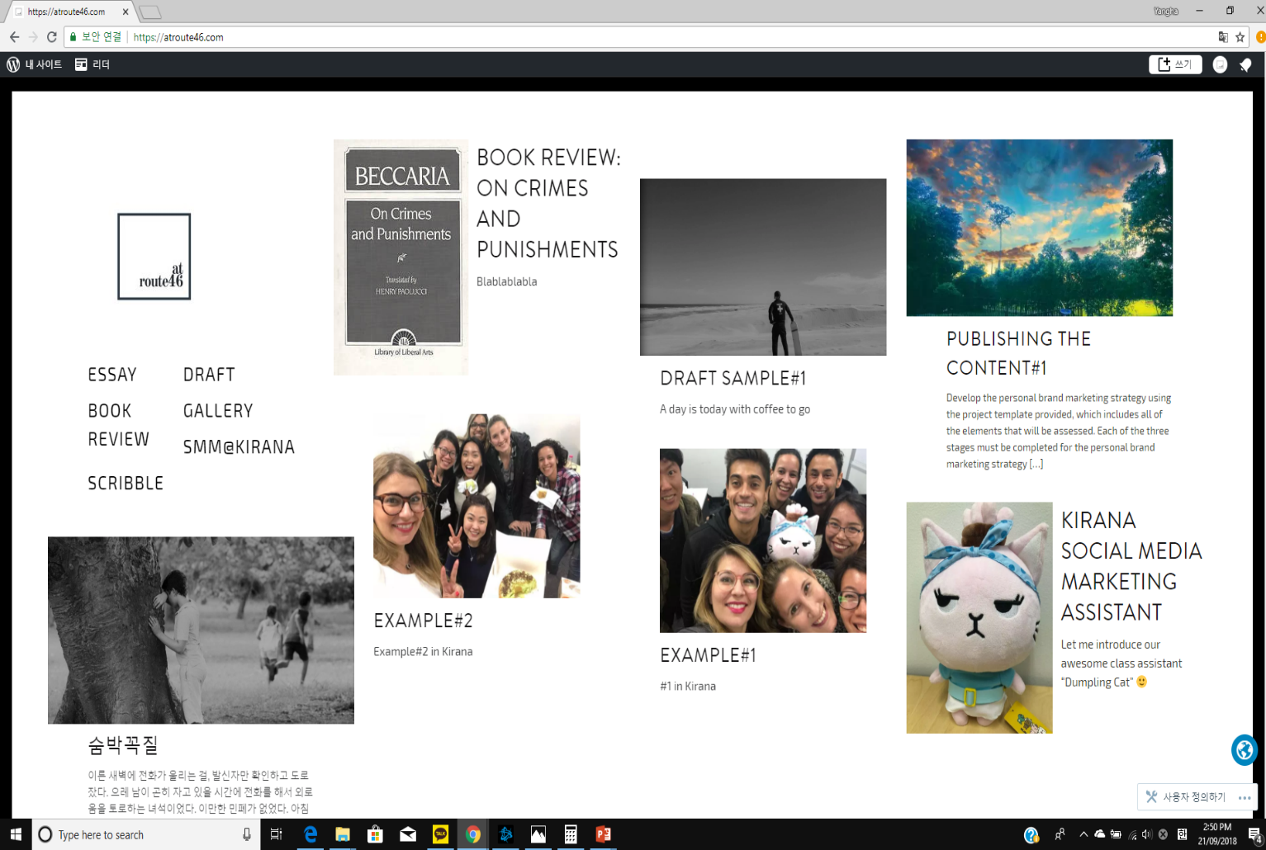
PERSONAL BRAND IDENTITY CANVAS
Brand Voice Calm and peaceful | Logo | Imagery | Colours Black and white | Personality Reasonable, Literary
 | Tag lines Liturature, book review |  | Social Media Networks Facebook Naver blog Linkedin Google+ Tumblr
Mission Statement I would be happy if I did ease one person’s mind by my writing

Slide 10
TARGET AUDIENCE overview
Target Audience Segment | Segment 1 | Segment 2
Demographic | People who love literature | People who have interest on reading a book
Personal Hobbies and Interests | Literature | Book
Professional Interests | Sharing and improving writing skill | Discussing certain books
What Social Media Networks Are They On? | Facebook, tumblr, google+, naver blog | Facebook, tumblr, google+, naver blog
How will Your Brand Add Value? | By improving my writing and critic skill | By improving my writing and critic skill

Slide 11
PERSONAL brand STRATEGIC IDEAS TEMPLATE
Primary Marketing Objective | Personal Brand Marketing Opportunities | Strategic Ideas | Secondary Marketing Benefits
Increase followers | Increase the reputation in the literature industry | Publishing writings on my blogs Carrying out cultural exchange with other countries’ writers Discussing a lot with readers
 | Increase the reputation in the book industry | Regularly publishing a book review on my blogs Discussing a lot with readers

Slide 12
Personal brand MARKETING STRATEGY
Strategy Initiatives | Campaign / Always on | Content idea | Social media network(s) | Frequency | Key Performance Indicators (KPIs) | KPI Targets (per month)
1 | Always on | Book review | Tumblr Naver blog Facebook Linkedin | Once a month | Shares | 20
 |  |  |  |  | Likes, comments | 50
2 | Always on | Writings | Tumblr Naver blog Facebook Linkedin | N/A | Shares | 10
 |  |  |  |  | Likes, comments | 30
3 | Always on | Humorous posts | Tumblr Naver blog Facebook | Once a day | Shares | 20
 |  |  |  |  | Likes, comments | 50

Slide 13
BUDGET DEVELOPMENT AND APPROVAL
Primary Content Marketing Objectives | Content Ideas | Always on / campaign basis | Forecasted Monthly Budget | Actual Monthly Budget | Budget Approval
Strategy | $0 | $0 | $0 | $0 | Yangha Park
Content creation | $0 | $0 | $0 | $0 | Yangha Park
Distribution | $0 | $0 | $10 per month (Wordpress fee) | $10 per month | Yangha Park
Measurement and Reporting | $0 | $0 | $0 | $0 | Yangha Park
Totals | $0 | $0 | $10 | $10

Slide 14

Stage 3.
IMPLEMENTATION
PLAN

Slide 15
SOCIAL MEDIA MANAGEMENT PLATFORM EVALUATION
Social Media Management Platform | Advantages | Disadvantages | Price(per month) | Selection (tick which will be utilised for this marketing strategy)
Wordpress | Easy to make a blog, Easy to synchronize with facebook, tumblr, google+, linkedin, It allows to sell directly items that I have via paypal |  | $5(individual) $10(premium) $33(business) | X
Buffer | Able to post to Instagram, They have free option, Cheap price to be compared than others | They have only few functions | $0(starter) $15(starter pro) $99 to 399(business)
Sprout | Abundant social media management function | Little bit expensive for a starter of social media | $99(premium) $149(corporate) $249(enterprise)

Slide 16
PERSONAL BRAND 3 WEEK MARKETING SCHEDULE
Sunday | Monday | Tuesday | Wednesday | Thursday | Friday | Saturday
23 Sep | 24 Sep | 25 Sep | 26 Sep | 27 Sep | 28 Sep | 29 Sep
Writing | Humorous post | Humorous post | Humorous post | Humorous post | Humorous post | Book Review
30 Sep | 1 Oct | 2 Oct | 3 Oct | 4 Oct | 5 Oct | 6 Oct
 | Humorous post | Humorous post | Humorous post | Humorous post | Humorous post
7 Oct | 8 Oct | 9 Oct | 10 Oct | 11 Oct | 12 Oct | 13 Oct
Writing | Humorous post | Humorous post | Humorous post | Humorous post | Humorous post

Slide 17
PERSONAL BRAND IMPLEMENTATION PLAN
Strategy | Roles and Responsibilities Actions required | Resources Required Position of task owner | Start Date | Due Date
Writing | Writing a manuscript | Yangha Park | 23 Sep | 30 Sep
 | Revision | Yangha Park | 30 Sep | 7 Oct
Book Review | Reading a book | Yangha Park | 23 Sep | 26 Sep
 | Writing a review | Yangha Park | 26 Sep | 27 Sep
 | Revision | Yangha Park | 27 Sep | 29 Sep
Humorous post | Looking up good stuff on the internet and share it | Yangha Park | 24 Sep | 24 Sep

Slide 18
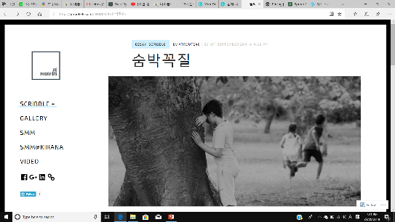
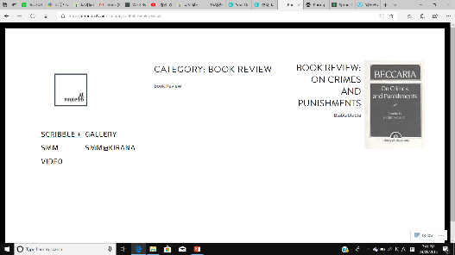
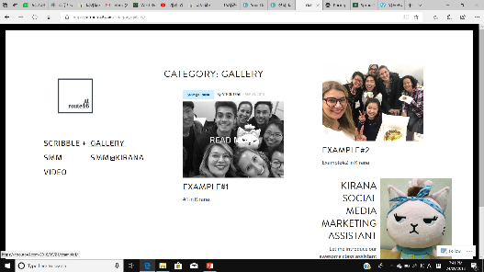
PERSONAL BRAND MARKETING STRATEGY FOR WEEK 1
Detail the content for the first week of the personal brand marketing strategy including the headline, any imagery and associated links that will be included where applicable.
Social media network | Content Type | Post Content | Associated Imagery | Associated Link / Tags (if applicable)
Tumblr Naver blog Facebook Linkedin | Writing | Writing |  | https://atroute46.com
Tumblr Naver blog Facebook Linkedin | Book review | Book review |  | https://atroute46.com
Tumblr Naver blog Facebook | Humorous post | Humorous post |  | https://atroute46.com

Slide 19
PERSONAL BRAND MARKETING STRATEGY FOR WEEK 2
Detail the content for the second week of the personal brand marketing strategy including the headline, any imagery and associated links that will be included where applicable.
Social media network | Content Type | Post Content | Associated Imagery | Associated Link / Tags (if applicable)
Tumblr Naver blog Facebook Linkedin | Book review | Book review |  | https://atroute46.com
Tumblr Naver blog Facebook | Humorous post | Humorous post |  | https://atroute46.com

Slide 20
PERSONAL BRAND MARKETING STRATEGY FOR WEEK 3
Detail the content for the third week of the personal brand marketing strategy including the headline, any imagery and associated links that will be included where applicable.
Social media network | Content Type | Post Content | Associated Imagery | Associated Link / Tags (if applicable)
Tumblr Naver blog Facebook Linkedin | Writing | Writing |  | https://atroute46.com
Tumblr Naver blog Facebook Linkedin | Book review | Book review |  | https://atroute46.com
Tumblr Naver blog Facebook | Humorous post | Humorous post |  | https://atroute46.com

Slide 21
SMMBPB504A
Be
The
expert

